Slide 1



Los Angeles Crime Investigation: Data Driven Detectives
Abhinaysai Kamineni
Lasya Raghavendra
Neeraj Magadum
Aakash Hariharan
Amogh Ramagiri

Slide 2

Synopsis of Data
The thousands of recorded incidents varying by crime type, victim demographics, location, law enforcement and city officials.
Identifying meaningful trends and correlations such as how crime types vary by location.
Victim demographics relate to specific crimes, and how different weapons are used in different crime remains a critical challenge.

Slide 3

SMART QUESTION 1
How have the top three most common crimes from 2020 to the present been distributed across the top five areas where they are most frequently committed in Los Angeles, and are these trends increasing or decreasing in each area from 2020 to 2024?

Slide 4
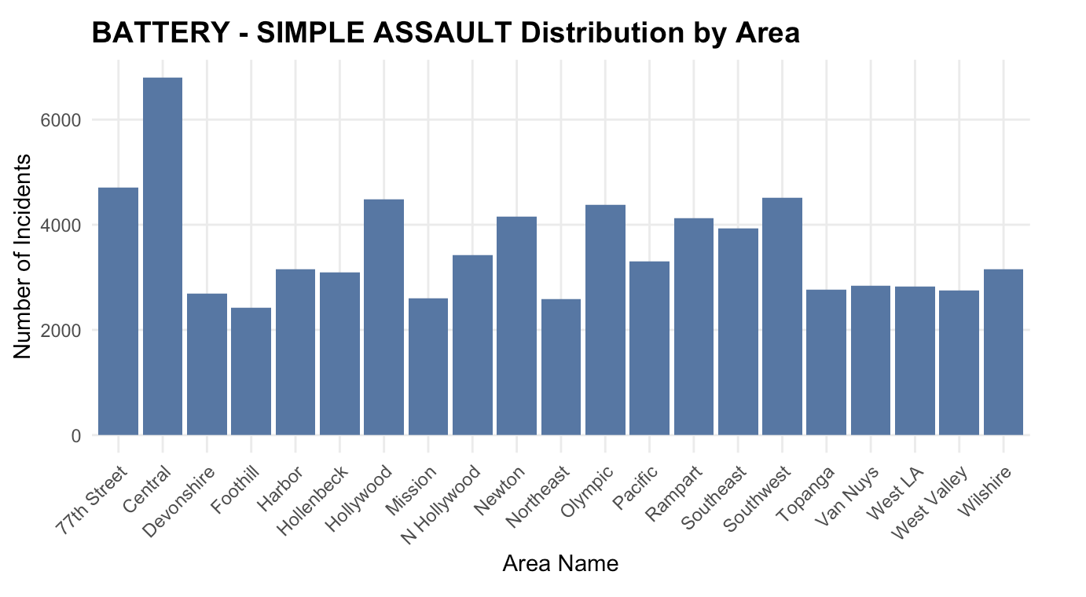
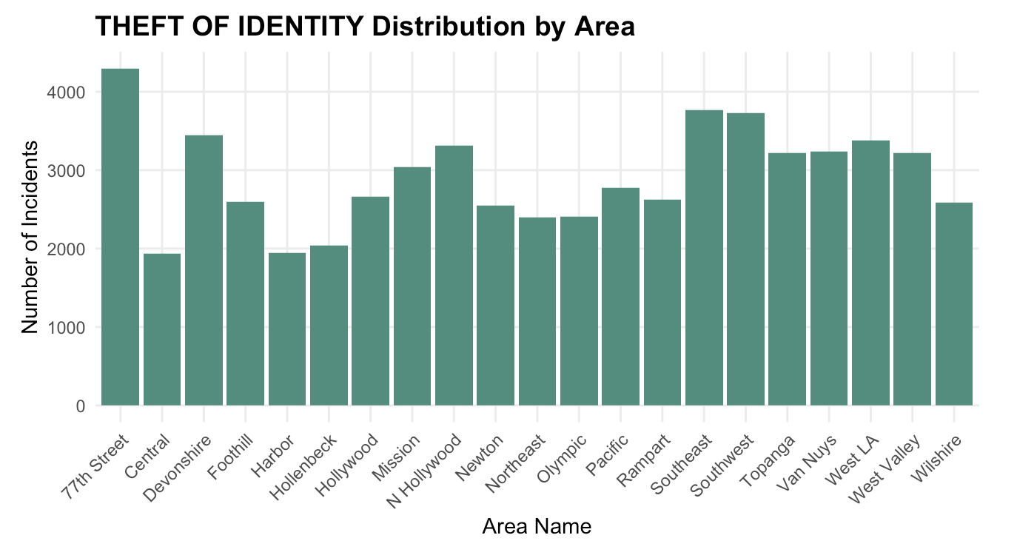

Slide 5
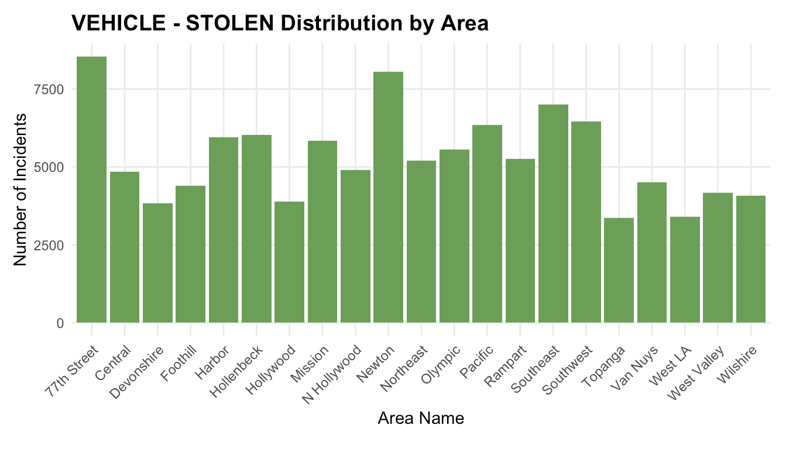
Top 3 Crimes:
BATTERY - SIMPLE ASSAULT
THEFT OF IDENTITY
VEHICLE - STOLEN
Top 5 Areas:
77th Street
Central
Hollywood
Pacific
Southwest

Slide 6
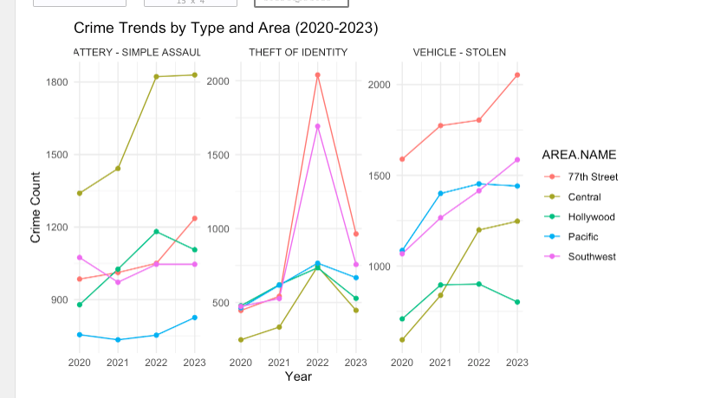
Crime Trend by Type and Area
Battery - Simple Assault: Central area peaks at 1,800 cases (2022)
Theft of Identity: Dramatic spike in 2022 (2,000+ cases)
Vehicle Theft: Steady increase, 77th Street reaching 2,000 cases by 2023

Slide 7
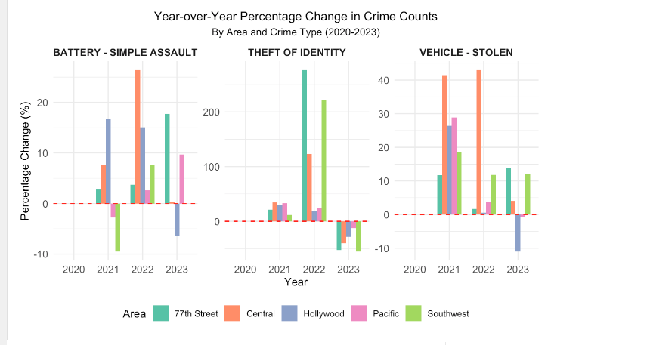
Year-over-Year Percentage Change in Crime Counts
Central shows highest volatility
Pacific shows most stable patterns
77th Street shows steady increases

Slide 8
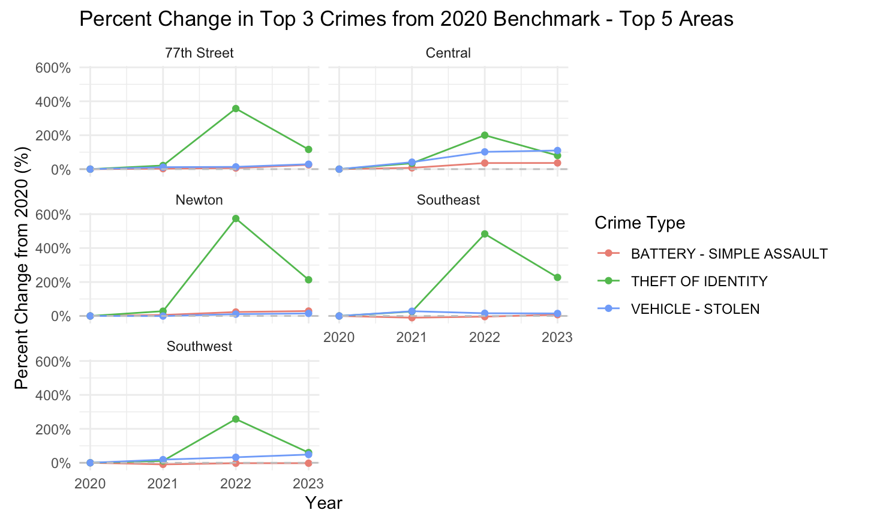
This analysis highlights Theft of Identity as an emerging concern in multiple areas, suggesting a need for targeted intervention.

Slide 9
Peak Year: 2022
• Highest crime rates in most areas.
• Identity theft and battery assaults reached maximum levels.
• Vehicle thefts continued to rise.
Area-Specific Issues
• Central Area: Most affected by battery assaults.
• 77th Street: High vehicle theft rates.

Slide 10
Conclusion for Q1
The ANOVA analysis indicates that the crime counts vary by both the area and crime type.
This suggests that some areas might experience higher incidences of certain crime types than others
Some crime types occur more frequently regardless of location.
Crime trends vary by area and type, indicating that crime prevention strategies may need to be tailored specifically to each area’s challenges.
The ANOVA test shows that both area and crime type significantly impact crime counts in Los Angeles

Slide 11
SMART QUESTION 2
Which neighborhoods in Los Angeles have experienced the most significant increases in crime rates from 2020 to 2023 with particular attention to demographic factors (race and sex of victims), and what insights can be drawn from Area's significant increase in crimes?

Slide 12
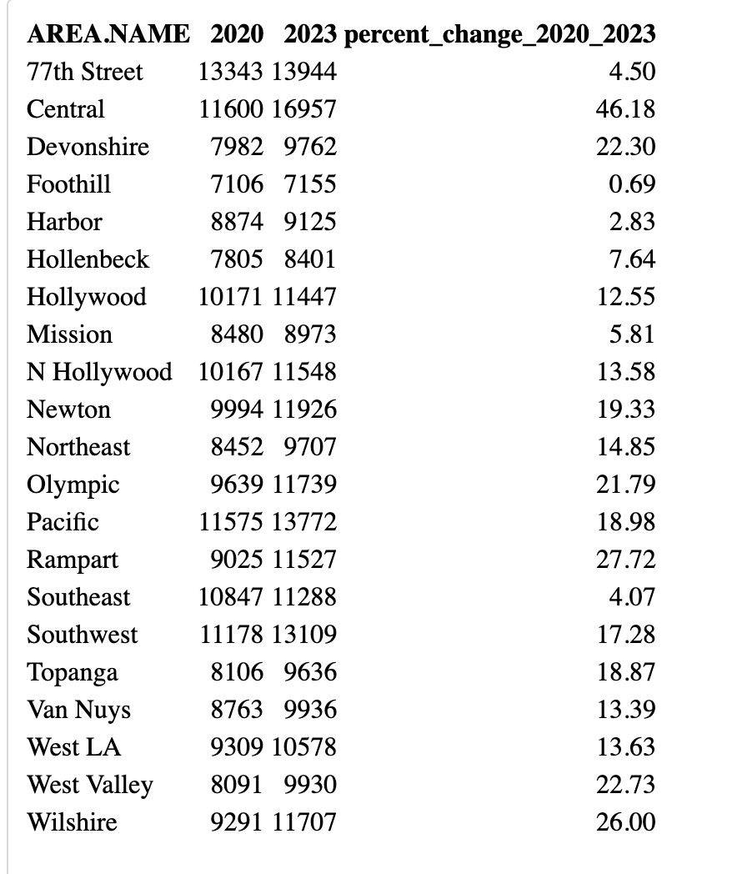
Calculating Year-Over-Year Percentage Change:-
High Crime Growth: Central, Rampart, Wilshire, and Olympic areas show the highest crime increases from 2020 to 2023, with Central leading at 46.18%.
Consistent Crime Challenges: Newton and North Hollywood have steady crime growth, indicating persistent issues that need continuous monitoring.
Stable Crime Rates: 77th Street and Southeast show minimal increases (4.5% and 4.07%, respectively), suggesting effective crime control in these areas.

Slide 13
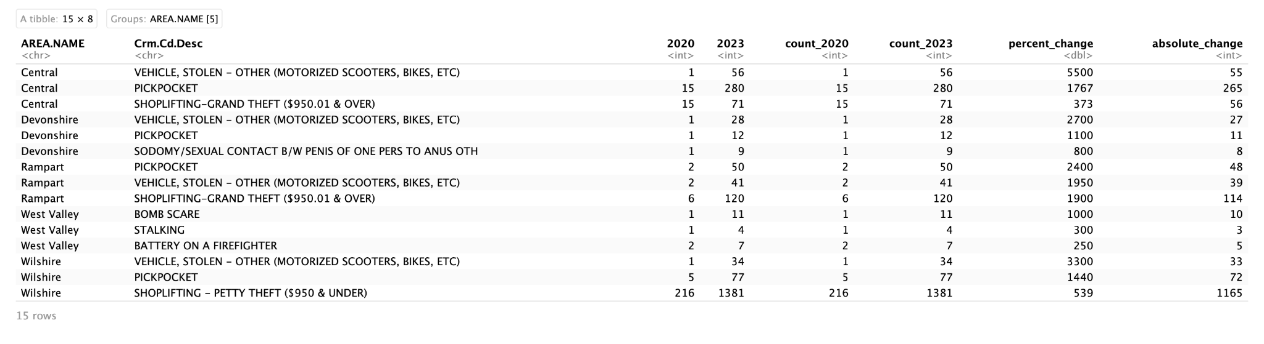
Top 3 Crimes in Areas with Highest Increases
Rising Theft and Pickpocketing: Central, Devonshire, Rampart, West Valley, and Wilshire show high increases in theft-related crimes, particularly vehicle theft and pickpocketing.
Targeted Crime Types: Specific crimes, like pickpocketing in Central and bomb scares in West Valley, highlight areas needing focused crime prevention.
Overall Increase in Property Crimes: The data shows a notable rise in property crimes across these top neighborhoods, pointing to changing crime patterns that may require specific responses.

Slide 14
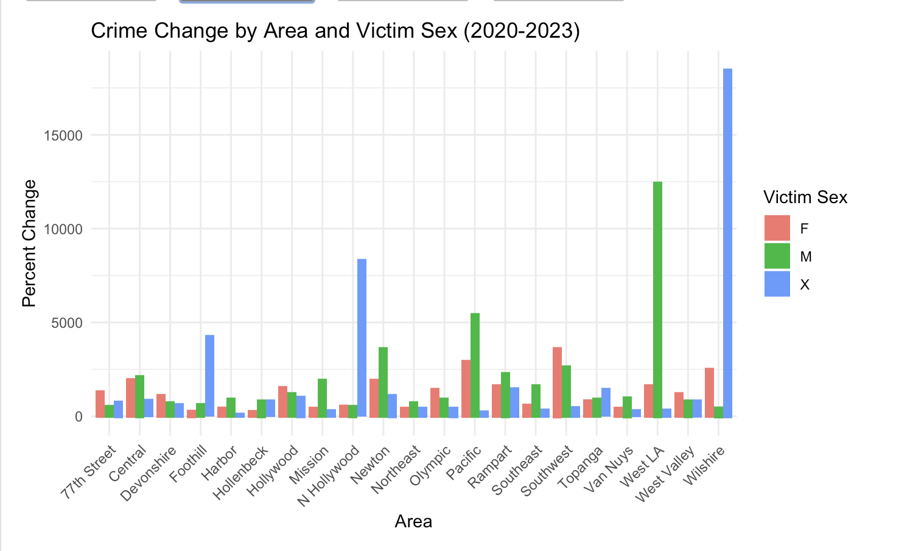
Crime Change Analysis by Sex and Race :-
Rise in Unknown Gender Cases: Newton, West LA, and Wilshire show high crime growth in unknown gender cases, hinting at data gaps or rising incidents.
Gender-Specific Hotspots: Wilshire and West LA see significant crime increases for both genders.
Area-Specific Trends: Pacific and Rampart show growth in male victim cases, while Foothill sees more growth among female victims, highlighting demographic-specific patterns.

Slide 15
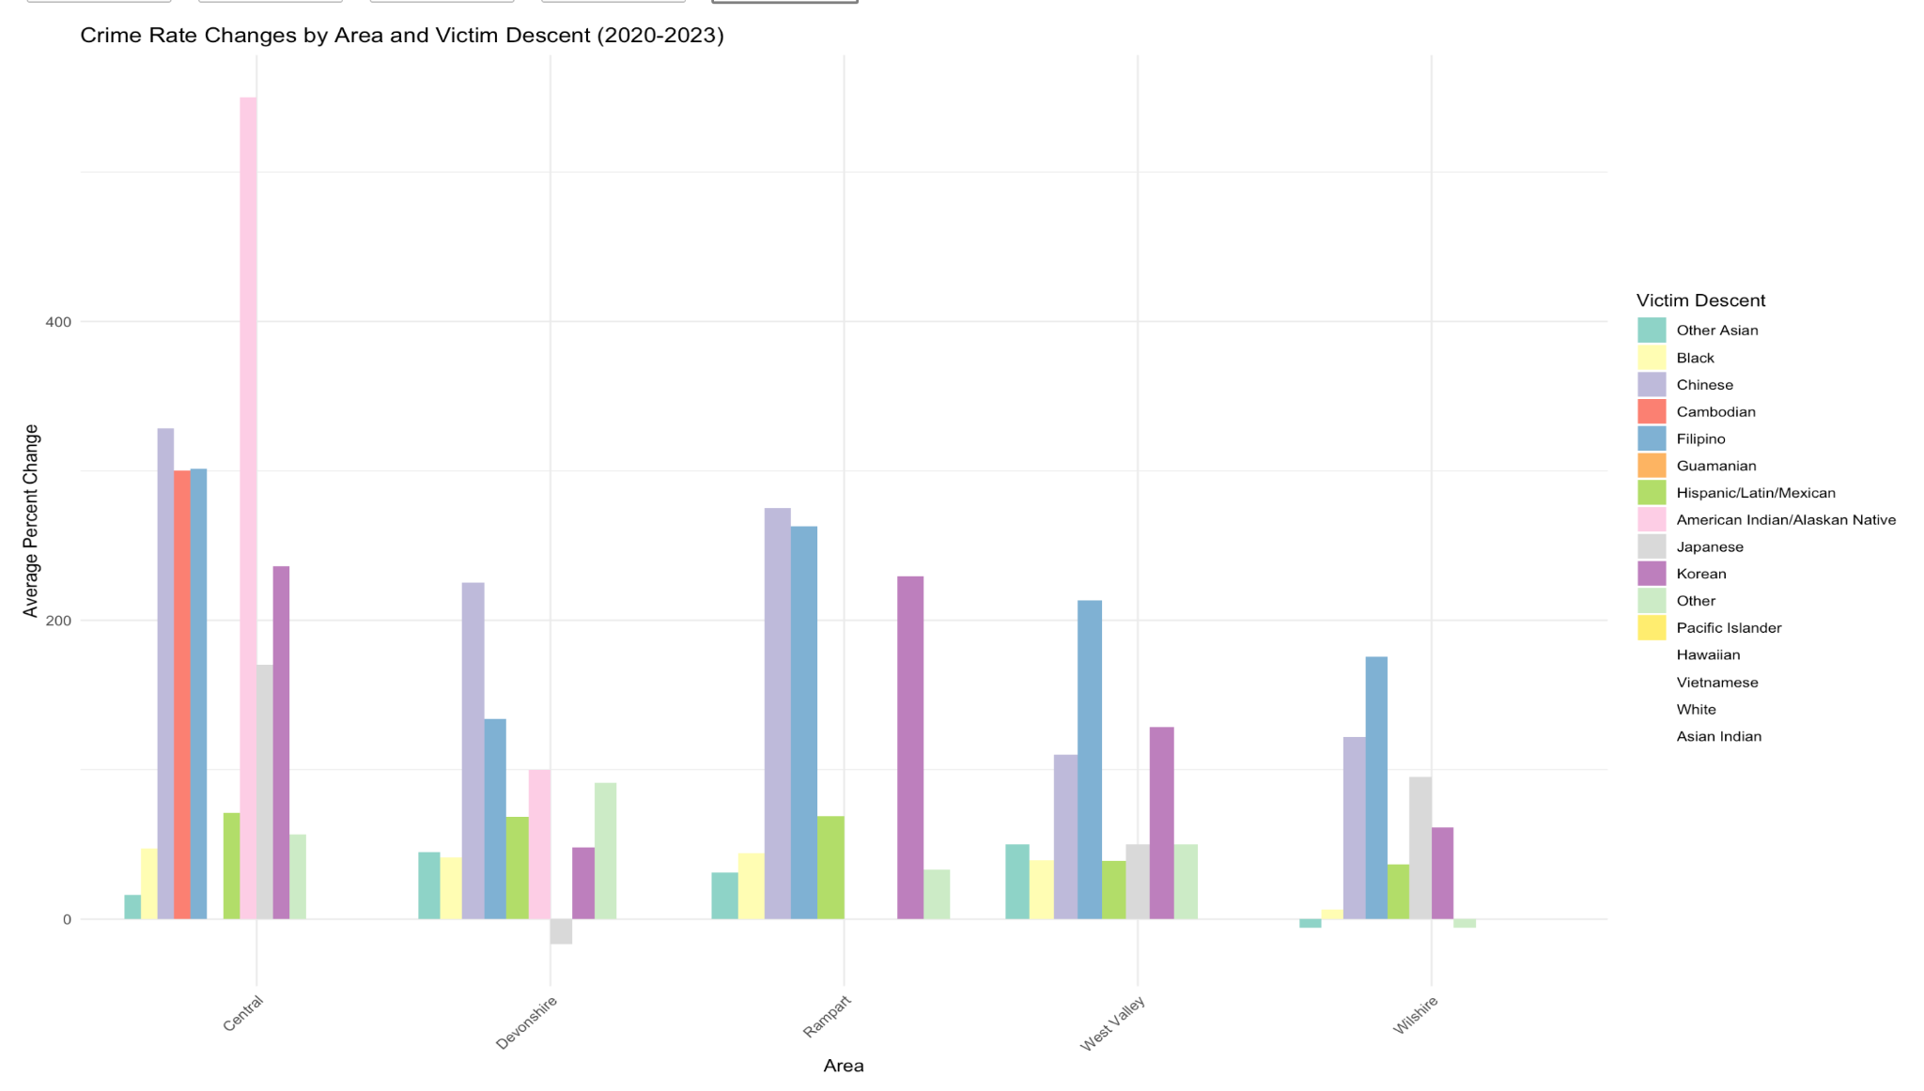
Crime Change Analysis by Sex and Race
1. High Growth in Unknown Descent: Wilshire shows a major increase in crimes with unknown descent victims, suggesting data collection gaps.
2. Targeted Descent Groups: Central, Devonshire, and Rampart report high crime growth for Filipino, Indian, and Korean victims, indicating possible targeted impacts.
3. Area-Specific Patterns: Unique crime trends across areas highlight the need for tailored strategies based on neighborhood demographics.

Slide 16

SMART QUESTION 3
How does the frequency of crimes in Los Angeles vary by victim descent, and are there
significant geographic patterns (based on latitude and longitude) associated with specific victim
groups?

Slide 17
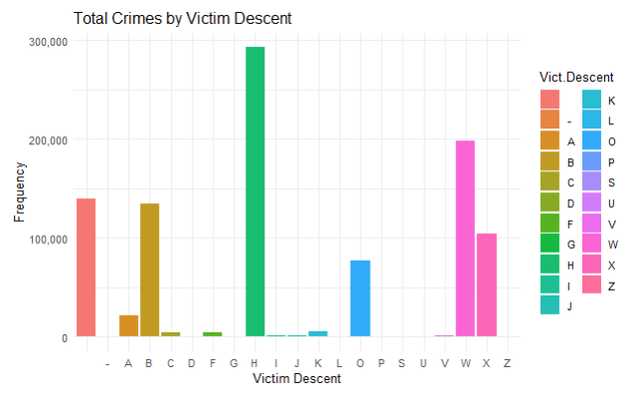
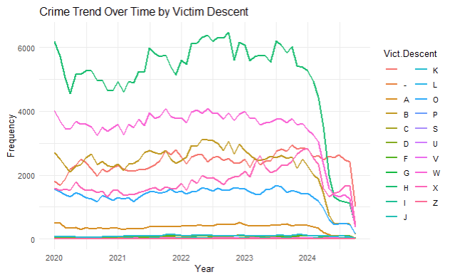
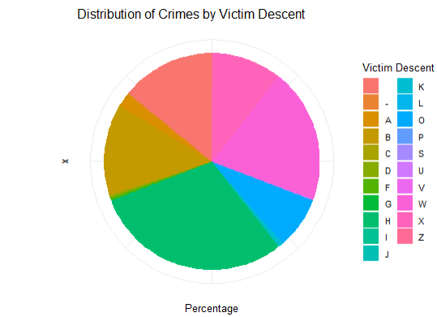
Total Crimes Distribution based on Victim Descent
Bar Plot Representation
Line Plot Analysis
Pie Chart Overview
Highest Crime Frequency: Victim descent groups "G" and "W" reflect the highest crime frequencies, with "G" reaching nearly 300,000 incidents and "W" exceeding 200,000.
Smaller Group Representation: Certain groups like "C", "K", "O" display much lower frequencies, indicating smaller reported incidents of crime.
Overall Trend: The crime frequency trends for various victim descent groups from 2020 to 2024. Descent group "G" consistently has the highest crime frequency.
Steady vs. Fluctuating Trends: While groups like "G" and "W" exhibit some fluctuation, other groups, such as "C" and "I", remain relatively stable but at much lower frequencies.
Largest Victim Groups : Certain descent categories which include B,G,O have a higher proportion of crime victims.
Smaller Victim Groups: Categories such as X, Y, Z show lower victim percentages, suggesting these groups experience fewer recorded crimes.

Slide 18
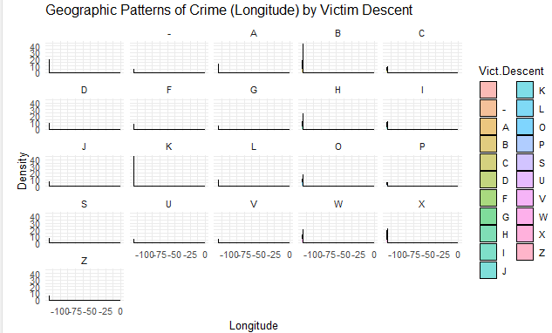
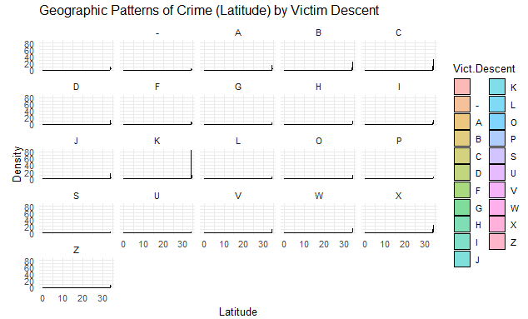
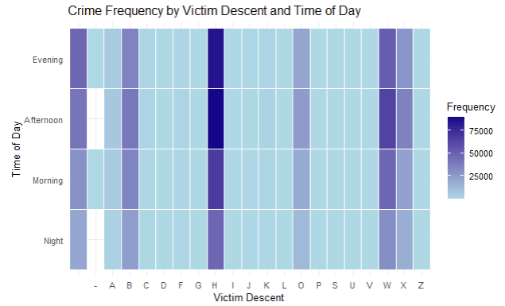
Crime activities with regards to Geopatterns
Multiple Density Plot for Longitude
Multiple Density Plot for Latitude
Heat Map Quadrants
Sparse Distribution for Most Groups: The density curves are relatively flat, indicating a more dispersed or low-density crime pattern across geographic areas, without significant clustering.
Low Density Across Most Longitudes: The majority of victim descent categories show minimal density across longitudes, with few or no peaks.
Notable Trends: Certain descent categories, like G and H, experience significantly higher crime frequencies during Evening hours.
Consistent Crime Levels Across Groups: Most descent categories experienced consistent level of crime frequency throughout the day, considering fews exceptions that show peak times, especially in the evening.
Most victim descents show minimal variation or activity across the latitude range (0-30), with generally low or flat density.
A few categories, like "P" and "C," have small but density spikes..

Slide 19
Statistical Inferences and Further Analysis
The ANOVA tests for Longitude and Latitude suggest that crime distribution can be analysed and considered as spatial distribution.
The ANOVA test including Coordinates and Victim Descent highlights the relationship between victim descent and latitude is more dispersed.
T-Test Analysis shows moderate levels of significant variations along latitude than longitude.
Correlation Matrix Analysis suggest that there has been reflecting regional hotspots in towards the boundaries of east-west location for Group B & H which fluctuating frequency.
Conclusion: - Victim Descent has significant correlation with geographical patterns, with specific descent groups Group-B, H & G.

Slide 20
SMART Question 4
How do crime rates fluctuate during the holiday season, particularly in November and December, and what types of crimes occur during these months?

Slide 21
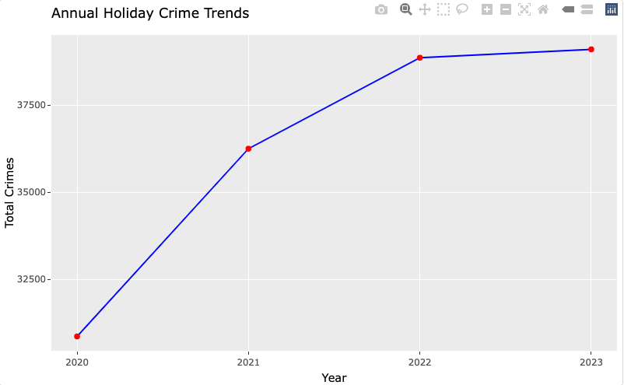
Annual Holiday Crime Trends Analysis
From 2020 to 2023, there is a noticeable upward trend in total crimes during holiday periods, showing an increase each year.
The largest increase occurs between 2021 and 2022, suggesting a potential impact of post-pandemic conditions or other socio-economic factors.
The trend slightly stabilizes between 2022 and 2023, indicating that holiday crime rates might have reached a level off.

Slide 22
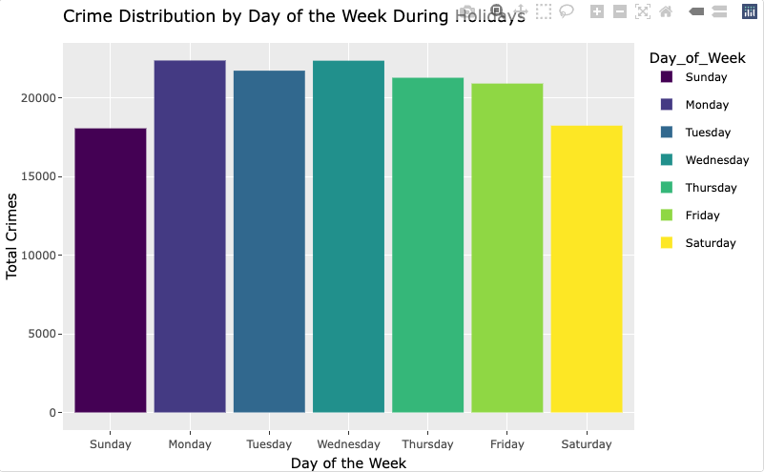
Crime Distribution by Day of the Week During Holidays
Higher crime rates on weekdays: The graph shows a significant number of crimes occurring from Monday to Friday compared to weekends.
Peak on Wednesday:
Wednesday records the highest number of crimes during the holiday season, indicating a possible trend or specific trigger.
Lowest on Sunday:
Observably lower crime rates on Sundays may suggest effective weekend policing or fewer active targets.

Slide 23
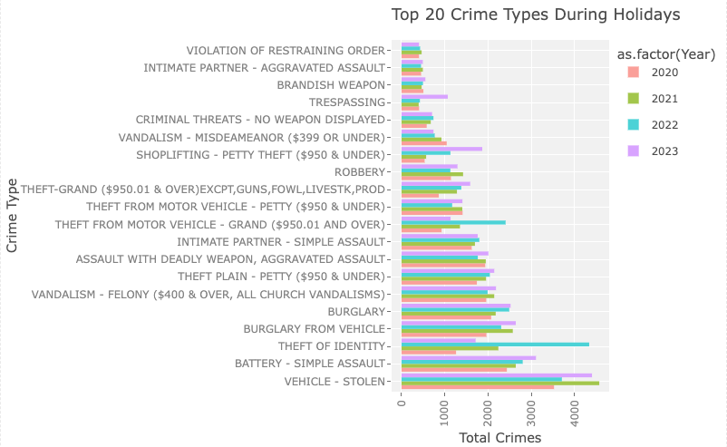
Top 20 Crime Types During Holidays
Vehicle-related crimes, especially “Vehicle - Stolen” and “Theft from Motor Vehicle”, appear to be among the highest across all years, indicating that vehicle-related crimes are a consistent concern during holiday periods.
“Theft Plain - Petty ($950 & Under)” and “Theft Grand ($950.01 & Over)” have significant counts, suggesting that both petty and grand theft are common during the holidays. Notably, 2022 shows a higher number of theft-related crimes in both categories.
“Theft of Identity” shows a notable increase, especially in 2022, indicating that identity theft may be on the rise during holiday seasons.

Slide 24


SMART QUESTION 5
Which crimes in Los Angeles exhibited the highest weapon usage, and which ethnicities and genders showed the most significant weapon involvement over the last five years?

Slide 25
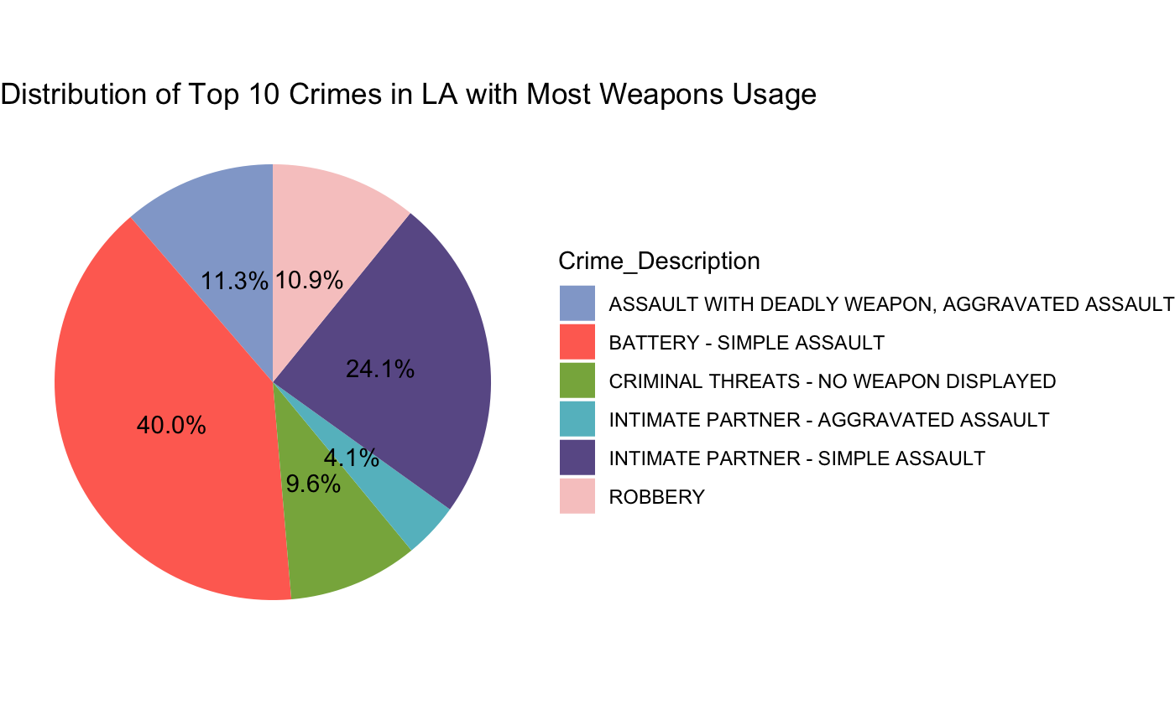
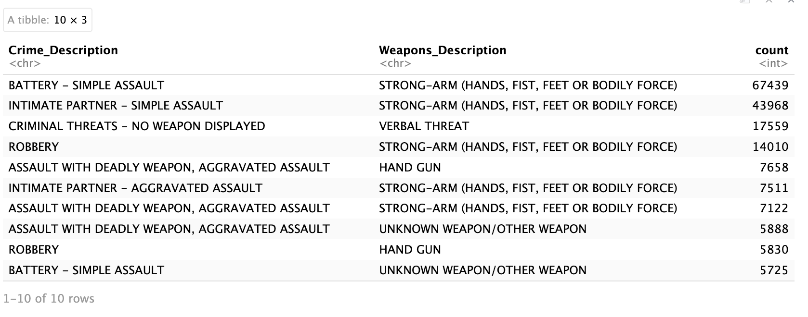
DISTRIBUTION OF CRIMES WITH MOST WEAPONS USAGE
Assaults dominate the weapon-related crime landscape in LA, particularly simple assaults.
Intimate partner violence (both simple and aggravated) is a prominent issue, reflecting recurring patterns of domestic conflict.
Robbery and aggravated assaults occur but are less frequent, suggesting that high-severity weapon crimes are comparatively limited.

Slide 26
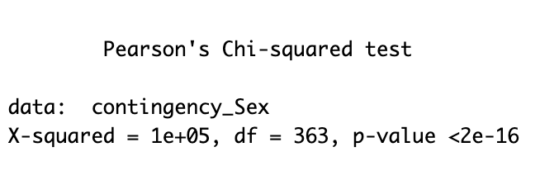
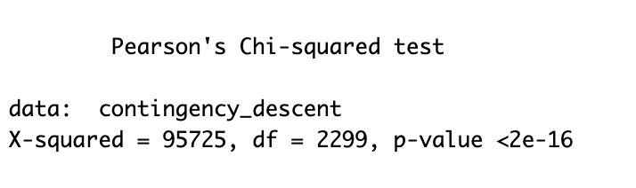
Statistical Insights: Chi-Square Test Outcomes
Statistically significant association found between the two categorical variables.
Chi-Square Tests conducted on Victim Sex and Crime as well as Victim Descent, and Crime.
High X-Squared values indicating difference in distribution of the features.
Accept the alternative hypothesis.(p -value < 0.05)
Conclude that the variables are dependent on each other.

Slide 27
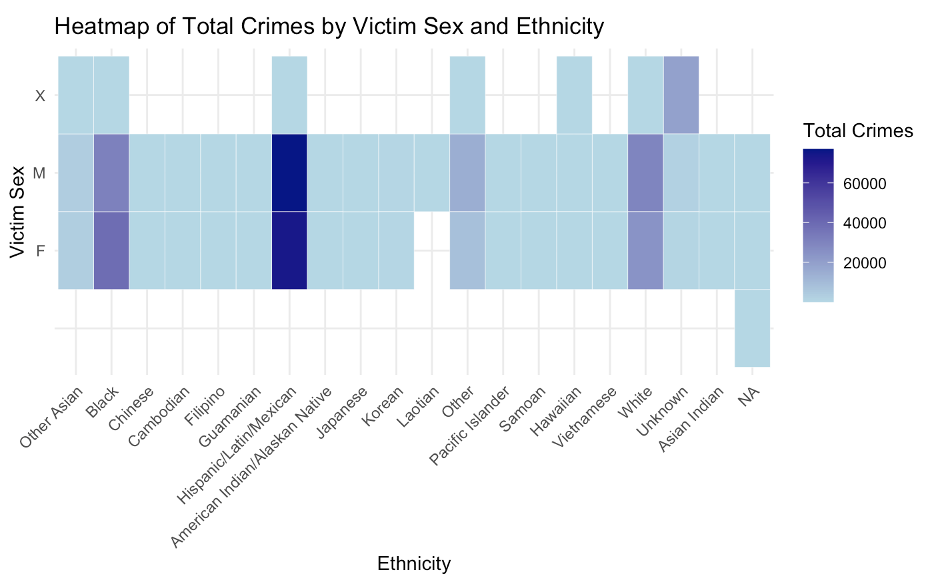
Crime Patterns Across Victim Demographics
Black and Hispanic/Latino/Mexican groups exhibit the highest crime counts, indicated by darker shades.
Crimes against females appear less frequent overall, with relatively lighter shades in general.
The Unknown Sex category also has significant counts across several ethnicities, particularly Black, Hispanic/Latino/Mexican, and White groups.

Slide 28
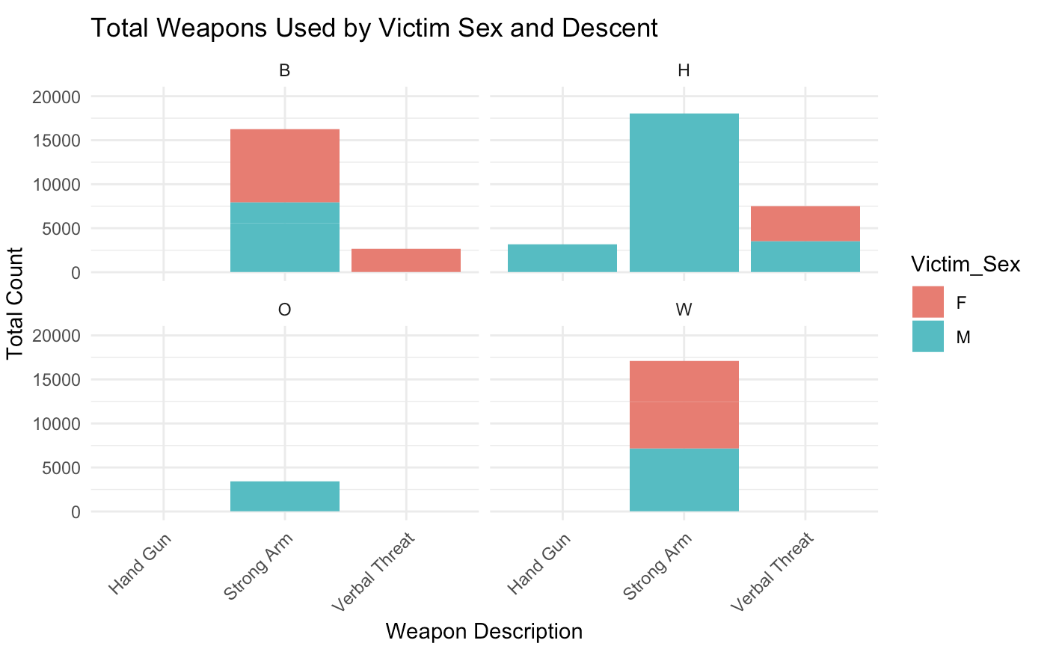
Analyzing Weapon Usage: Victim Sex and Descent
Across all categories, males (teal) are more frequently victims, especially in cases involving firearms.
Female victims (red) appear more frequently in non-weapon-based incidents
Handgun usage is notably higher for Black (B) and Hispanic (H) victims, with males being disproportionately represented.

Slide 29

01
Area can indeed be considered a significant factor in understanding and predicting which types of crimes are more likely to occur.
Crime trends in Los Angeles neighborhoods reveal significant increases in property crimes and distinct patterns across demographics, highlighting the need for targeted, area-specific strategies to effectively address and prevent crime growth.
02
There are notable geographical patterns for victim descent in North-South section of LA & less patterns were noticed in East-West sections.
Conclusion
03
The data suggests a need for better security and public awareness from November to December to reduce crime.
04
Battery is the crime most commonly associated with weapon usage in LA, with Hispanic individuals and male population showing significant involvement in these offenses as victims.
05
Notes:
Emphasize for Mel’s Question: Company is doing great!

